Slide 1
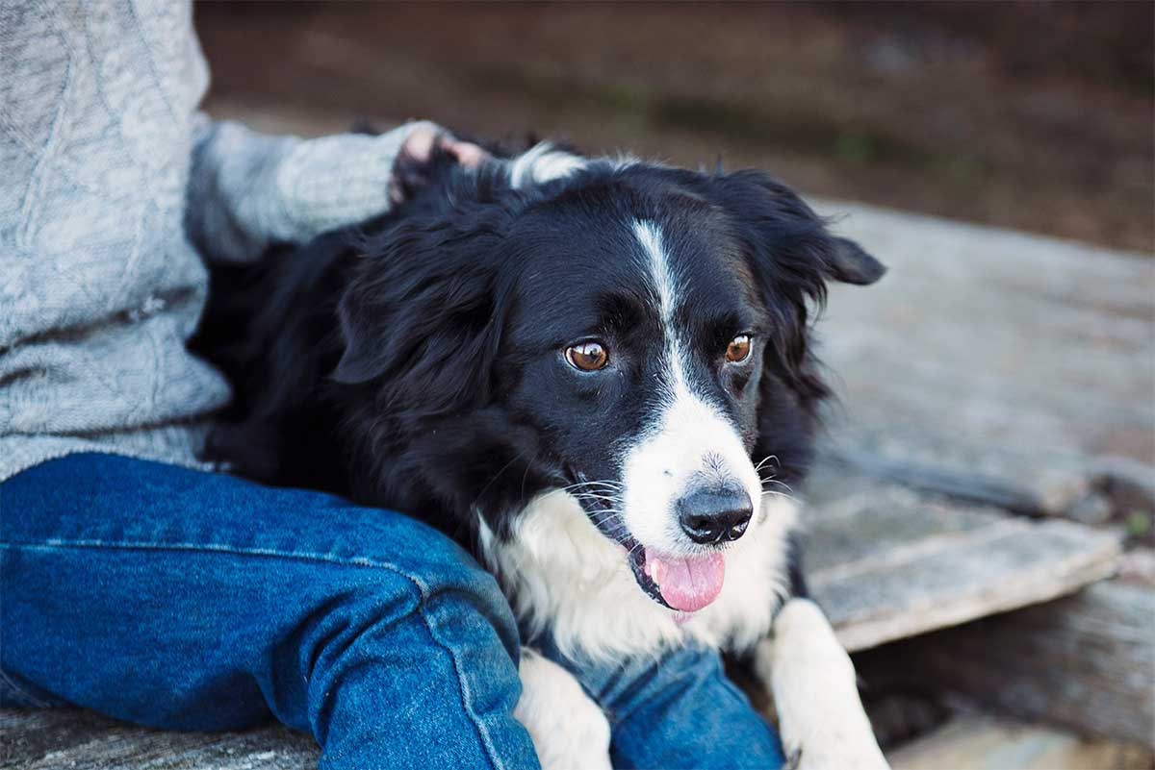
Adopt a Paw
HCI 440
Project Contributors:
Tina Elling
Karina Frasco
Rosa Sanchez
Michelle Wu
Rahul Janardhanan

Slide 2
Outline
Project Summary
Exploratory Research Summary
Primary Persona
Design Scenarios
Conceptual Designs
Intermediate Wireframes
Detailed Designs
Insights from Structured Inspection
Insights from Usability Evaluation
Key Learning
Next Steps

Slide 3
Project Summary

Slide 4
System Concept Statement
Adopt a Paw is an app that provides first-time pet owner information on pet care, associate costs of owning a pet, the ability to find a pet that matches their lifestyle, and guides them through the adoption process.
A successful experience for both pet owners and the pet will allow for better-matched adoptions and a well educated pet owner. The bond that will be created between the pet owner and the pet will allow them to have a real home with the care and attention they need. The system will pull information from local shelters that will provide bios, stories, and medical information about pets that are up for adoption. The app will consist of several sections to help educate the user on the responsibilities, cost, and care for their new pet. This app will facilitate the ability to match the user with a pet that fits their personality and lifestyle. The goal for this app is to educate people, and help them understand the responsibilities and challenges of being a good pet owner, this will lower the chance of pet abandonment, and help those abandoned animals be adopted into good homes.

Slide 5
Exploratory Research Summary

Slide 6
Guiding Research Questions
What motivations are driving the decision to own a pet?
What misconceptions do users have about owning a pet?
Does the user understand the responsibilities of being a pet owner (puppy through adult; healthy and sick), and care for the pet? (Vet, health, food, training, and etc.)
Does the user understand the cost (upfront and lifetime of pet), and does their lifestyle accommodate with owning a pet?
Will the user and family (if applicable) be able to adjust to a new pet or understand the adjustments?

Slide 7
Research Methods Used
Qualitative Analyses - Approach and Method
In order to determine how much knowledge, the user had relating to pet ownership and adoptions we conducted a series of semi-structured interviews using a small sample of the population. In total five participants were interviewed ranging from a various background but all having a common theme of being a first-time pet owner who was looking to adopt. Questions were focused on their motivations for wanting to adopt a pet, they type of lifestyle they had and how it would accommodate a pet, the various cost associated with owning a pet, and their knowledge of how to properly care for a pet. Additional questions were asked to find out how they would go about finding information on the above subject matter. Most said they would Google it, ask the shelter, ask friends, or ask the veterinarian.

Slide 8
What We Learned
Why they want a pet
Most want one for companionship and to care for them or to help teach their children how to be responsible for someone besides them.
Life Style
All the participants interviewed stated they have a busy lifestyle that might not accommodate having a dog but it would be something to figure out after they got the dog. The participants said it would be an adjustment that would be worked out with other family members, if applicable.
Owner and Pet Match
In junction to life style, all participants had ideas about the criteria when selecting a new dog. Two participants were not looking to start with a puppy as they felt it was too much work and said they’d rather have an adult/older dog. They indicated that they’d like to know more about the breed as far as ease of training, behavioral issues, grooming, interaction with children, other people and other animals. It was also mentioned that if someone in the household had specific allergies they’d like to know what type of dog they could get.

Slide 9
What We Learned
Care
When it came to care, most knew they needed to feed, walk, take to the vet, and train but they all seemed unsure but said they’d look to others and the web to help them figure it out. They approached the challenges in the same manner referring to either friends, web, veterinarian or shelter to find their answers.
Cost
This was another area that participates had little knowledge and felt that they be able to figure it out. Most guessed or gave a number and when asked how they would investigate it they stated again that they’d ask friends or veterinarian, surf the web, or ask someone at the shelter.

Slide 10
Primary Persona

Slide 11

Primary Persona
Personal Description
Paul has decided that he’d like to adopt a family pet. He’s looking for an app that has information related to cost, care, and finding a pet that is good with children who have specific needs.
Technological
Paul owns several devices from laptops, iPads, and smartphones. He and his family are intermediate to advanced users.
Concerns & Frustrations
With having three children in elementary school and activities nights and weekends, Paul is concerned about the cost of owning a pet, having enough time to spend and care for the pet, and being able to house train the pet. He’s looking for information to help make the decision on getting a new pet.
Paul
Age: 43
Gender: Male
Marital Status: Married
Children: 3
Residence: Home owner
Education: College graduate
Goals & Motivations
Since Paul has never owned a pet he’s looking for the right pet for his family and their needs. He also wants his children to grow up with a pet but must find one that will be suitable with his child that has allergies.

Slide 12
Design Scenarios

Slide 13
Usage Scenario First Time Pet Owner
Paul wants to adopt a pet for his family since he never had one growing up and would like his children to learn how to care for a pet. He has several concerns about being a new pet owner such as the type of pet to get that fits his family's growing lifestyle, the right accommodations for the pet, and the cost of adopting and owning a pet. He decides to use a pet app on his mobile phone to help with his research. Upon opening the app, he notices several links that might be useful to help him make a decision. He starts with researching the type of pet and eventually finds one he likes which he believes will be good for his family. As he begins the reviewing the pet, he discovers this pet might not work out due to high costs and not being suitable for children. He goes back into the app to look for something that will help match his family/live style to a pet but his search only shows profiles of pets. He also wants to understand the costs associated with the matched pet. As he investigates further he finds a section of FAQ’s that has some information about cost but nothing about matching a pet to his family’s lifestyle and needs. He found information on the adoption process but after looking over the information still has questions. Although the app was useful, he needs more detailed information and prompts like to guide him through the process.

Slide 14
Design Scenario First Time Pet Owner
Paul wants to adopt a pet for his family since he never had one growing up and would like his children to learn how to care for a pet. He has several concerns about being a new pet owner such as the type of pet to get that fits his family's growing lifestyle, the right accommodations for the pet, and the cost of adopting and owning a pet. He decides to use a pet app on his mobile phone to help with his research. One of his main goals is to find a pet that will fit his family’s lifestyle, is children friendly, and be allergy friendly since one of his children has specific allergies. Upon opening the app, he notices several links on the main page that might be useful to help him make a decision. He starts with the “Pet Lifestyle Match” and is brought to a questionnaire that he will need to fill out. The form has a range of various questions that will help match a pet to his family’s lifestyle and needs. When Paul finishes the form he submits it and the results are returned. The results show a number of eligible pets that meet his requirements. After viewing each pet, Paul has an option to create a profile. This will allow him to add a pet to his favorites for later access. Next Paul wants to find out more about the cost and care of the pets he picked. On the main page he finds “Pet Costs” and “Pet Care”. In that section he finds he has the ability to select a pet from his favorites, answer a few questions about cost and care, and submit the form. The results show him general information, specific care and cost for that pet. He sees it also has links to learn more about each subject. Finally, the app offers information about adoption costs and process along with FAQs and online/downloadable forms. Paul is pleased with his experience using the app and now has the confidence and knowledge to become a first-time pet owner.

Slide 15
Conceptual Designs

Slide 16
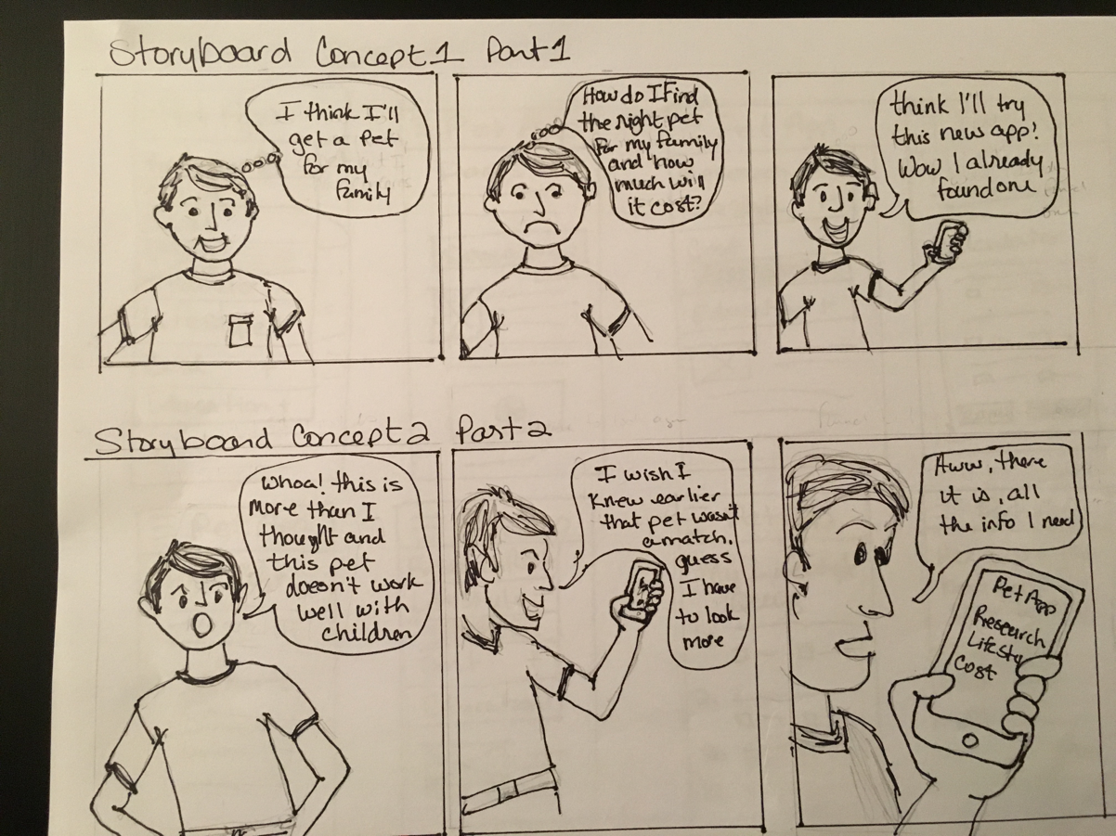
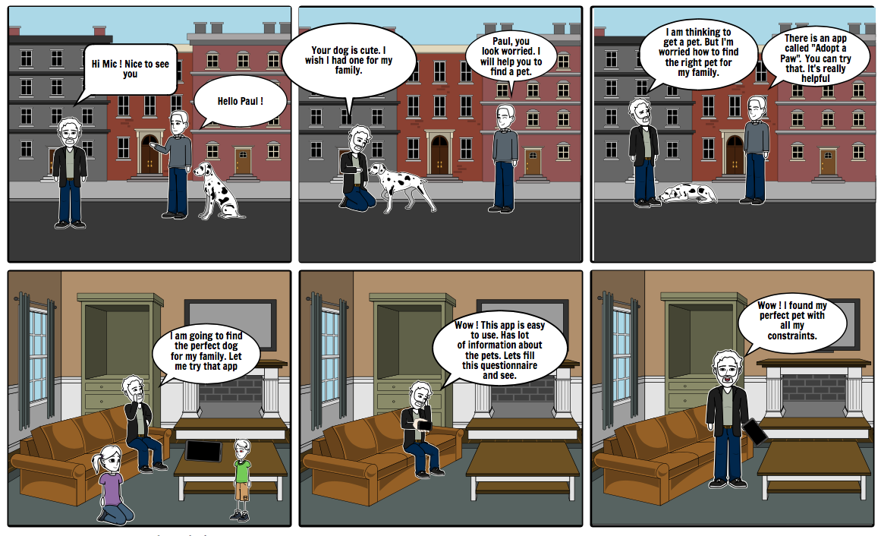
1

Slide 17
Intermediate Wireframes

Slide 18
Information architecture
Home
Lifestyle Match
My Favorite Pet
Adoption Process
About Us
Find a Pet
Pet Care
Pet Cost
Resources

Slide 19
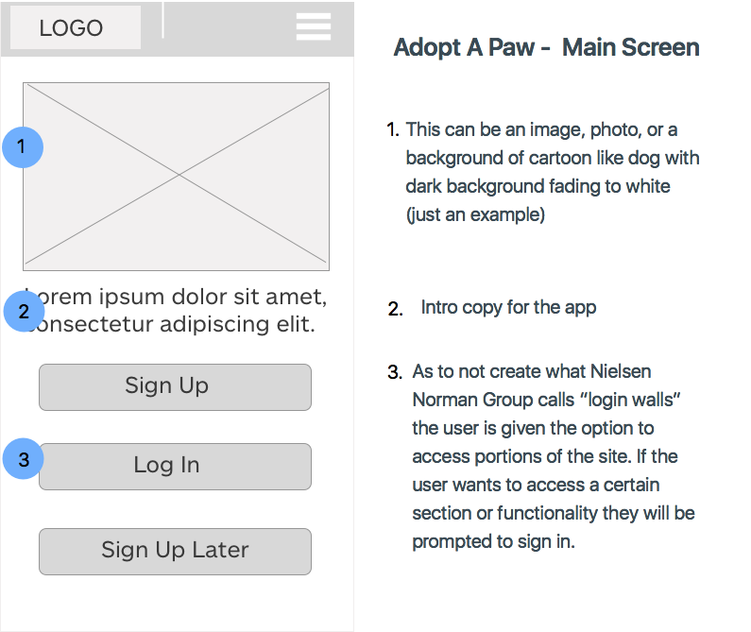
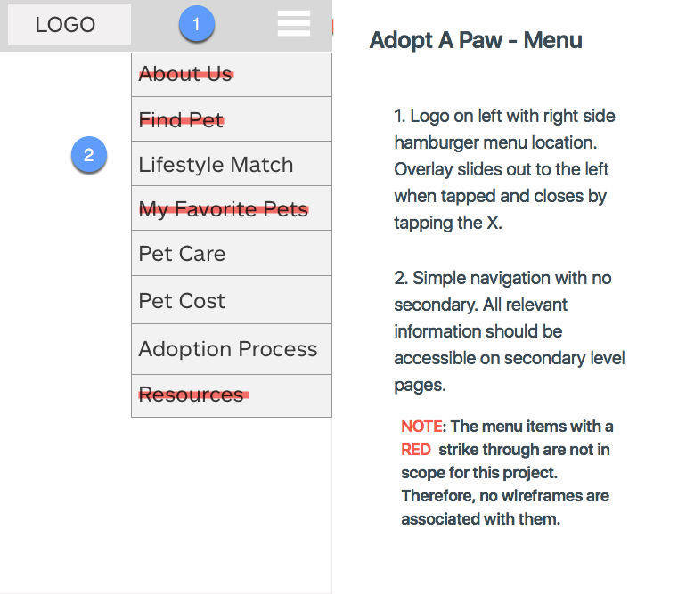
Main Screen and Menu

Slide 20
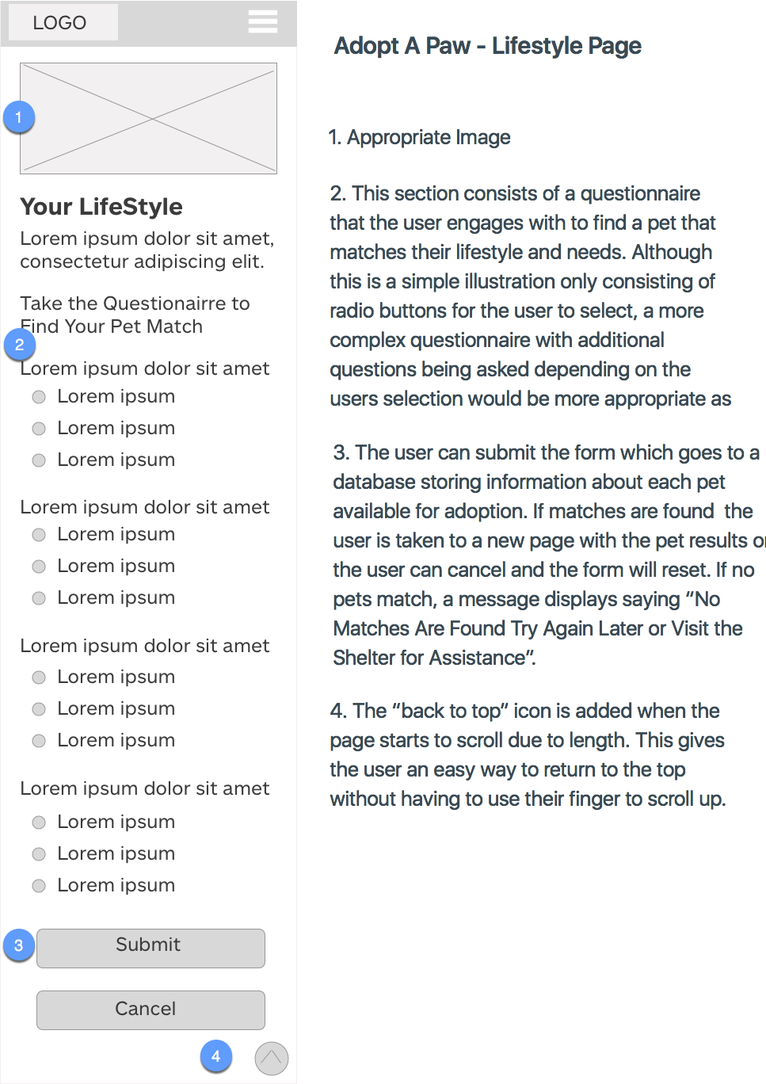
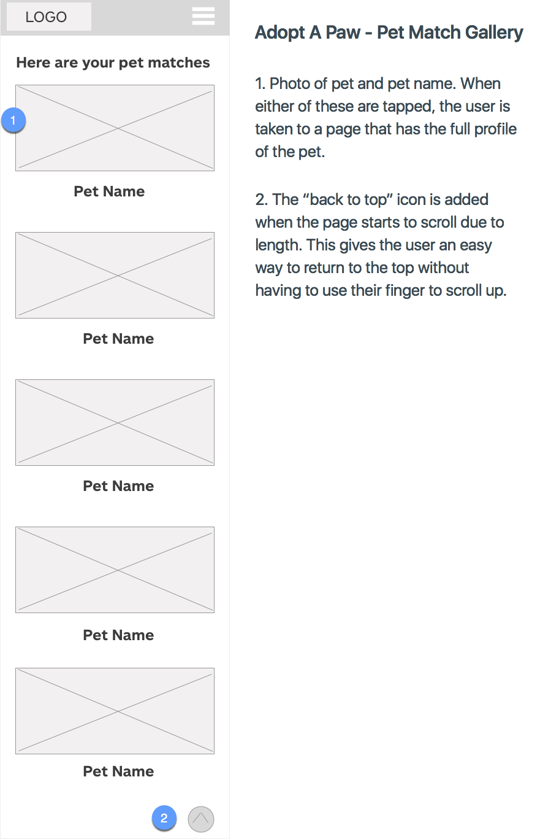
Lifestyle Page and Pet Match Gallery Results Page

Slide 21
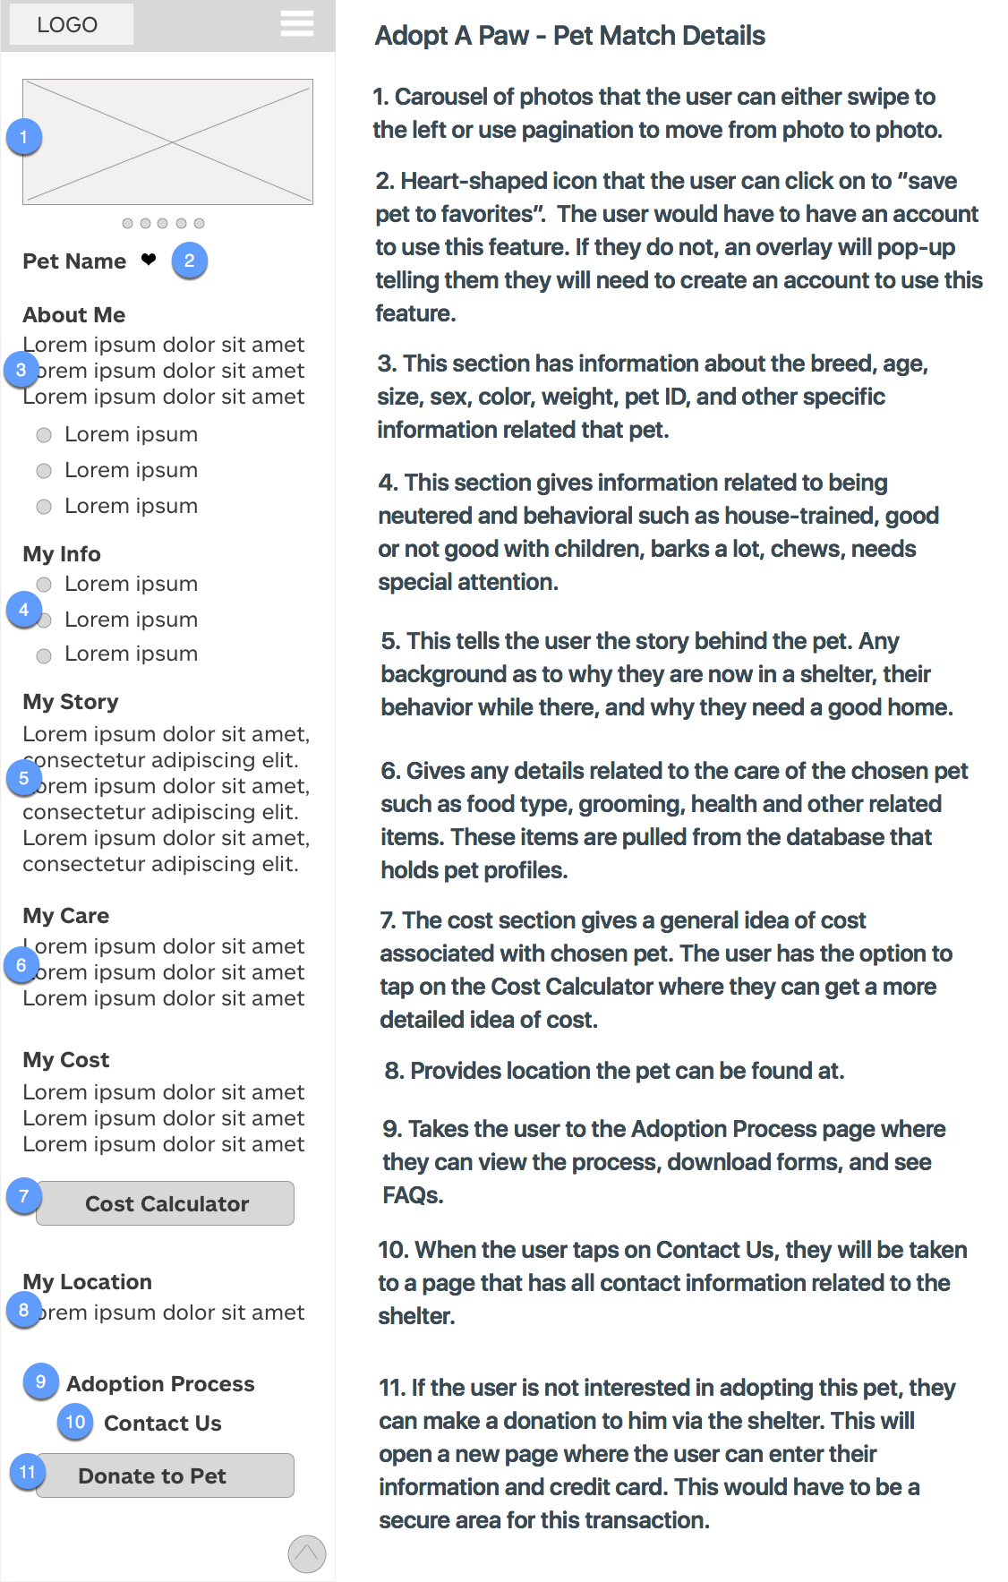
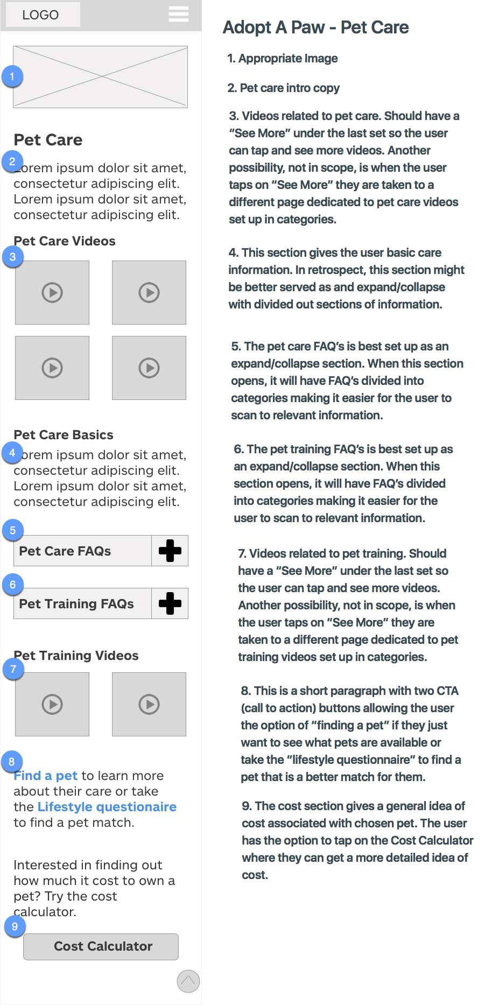
Pet Match Details and Pet Care Pages

Slide 22
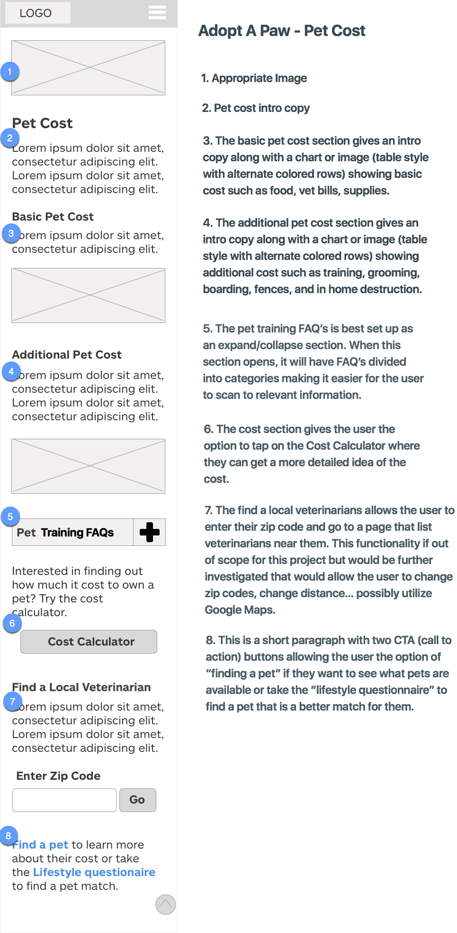
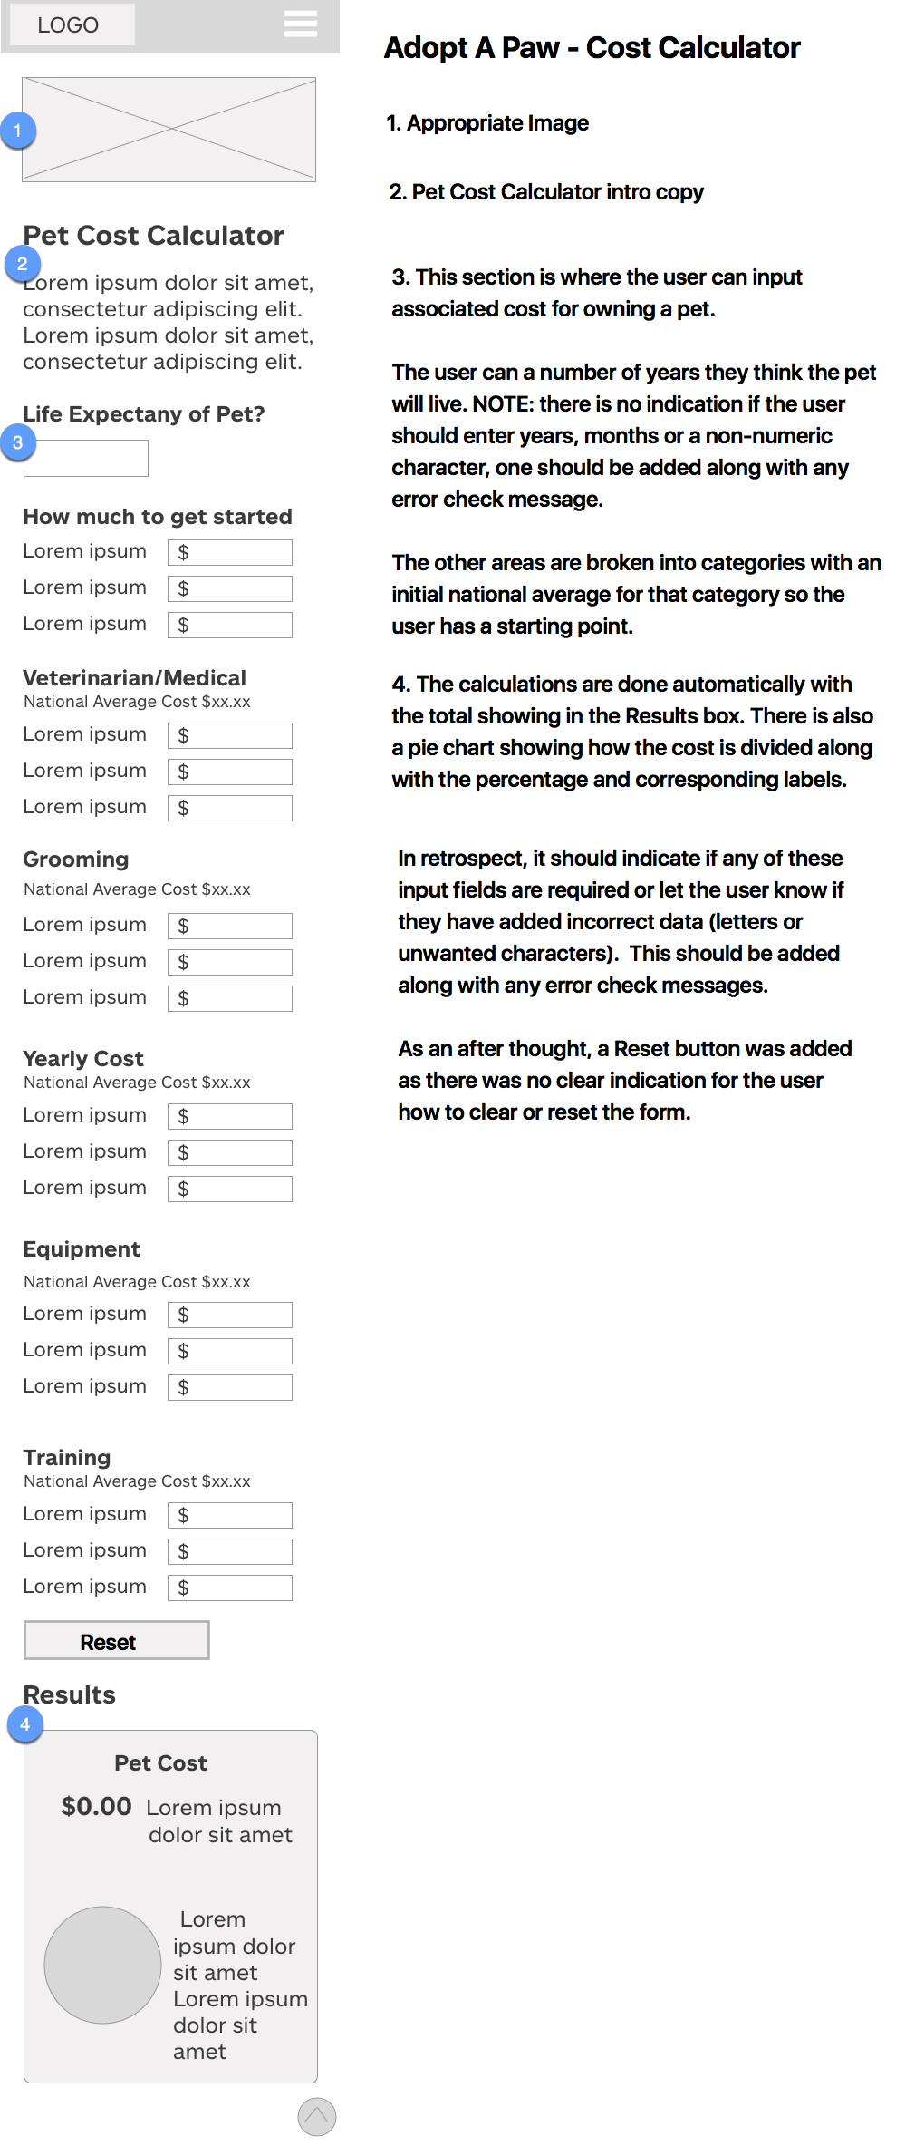
Pet Cost and Cost Calculator Pages

Slide 23
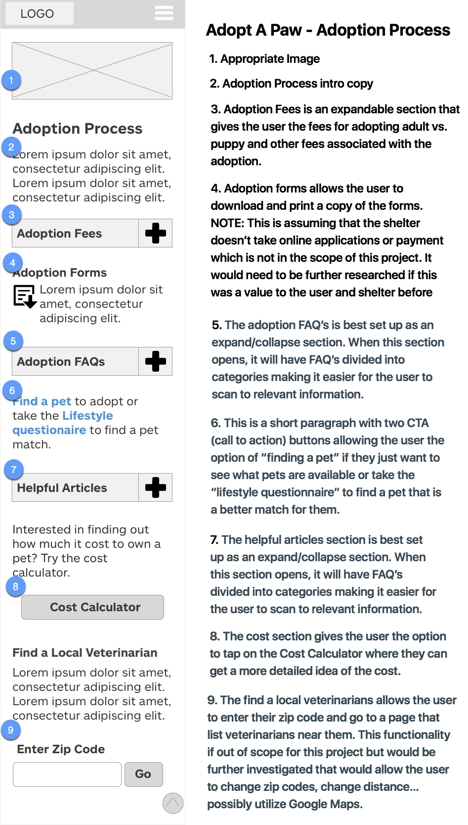
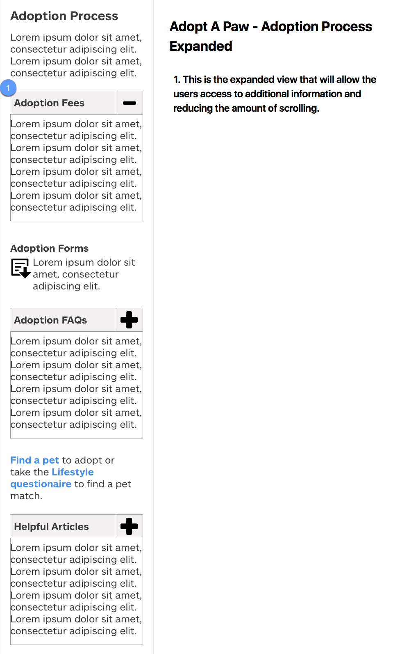
Adoption Process and Expanded View Page

Slide 24
Detailed Designs

Slide 25
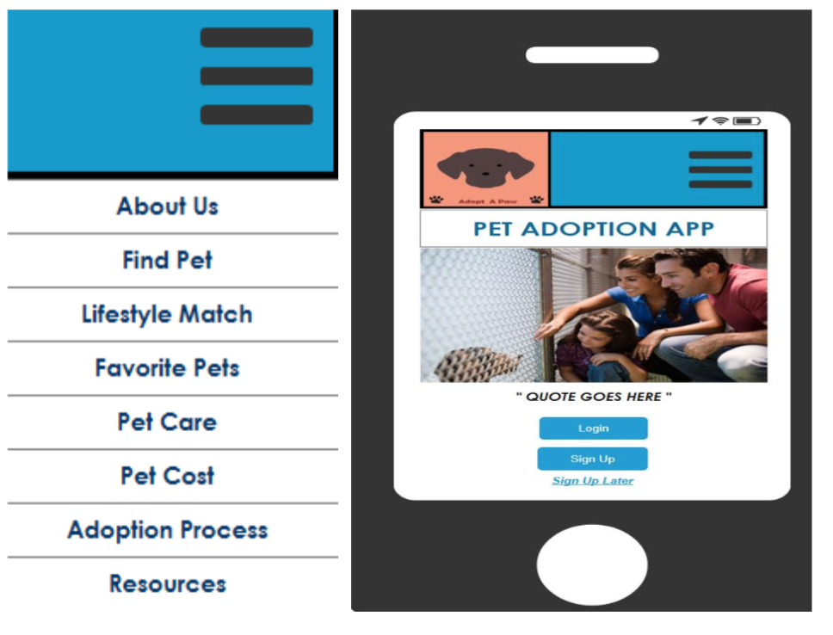
Main Screen
Menu is one level deep and accessible to the user
Log In, Sign Up and Sign Up Later options for the user if they just want to do some research without creating an account

Slide 26
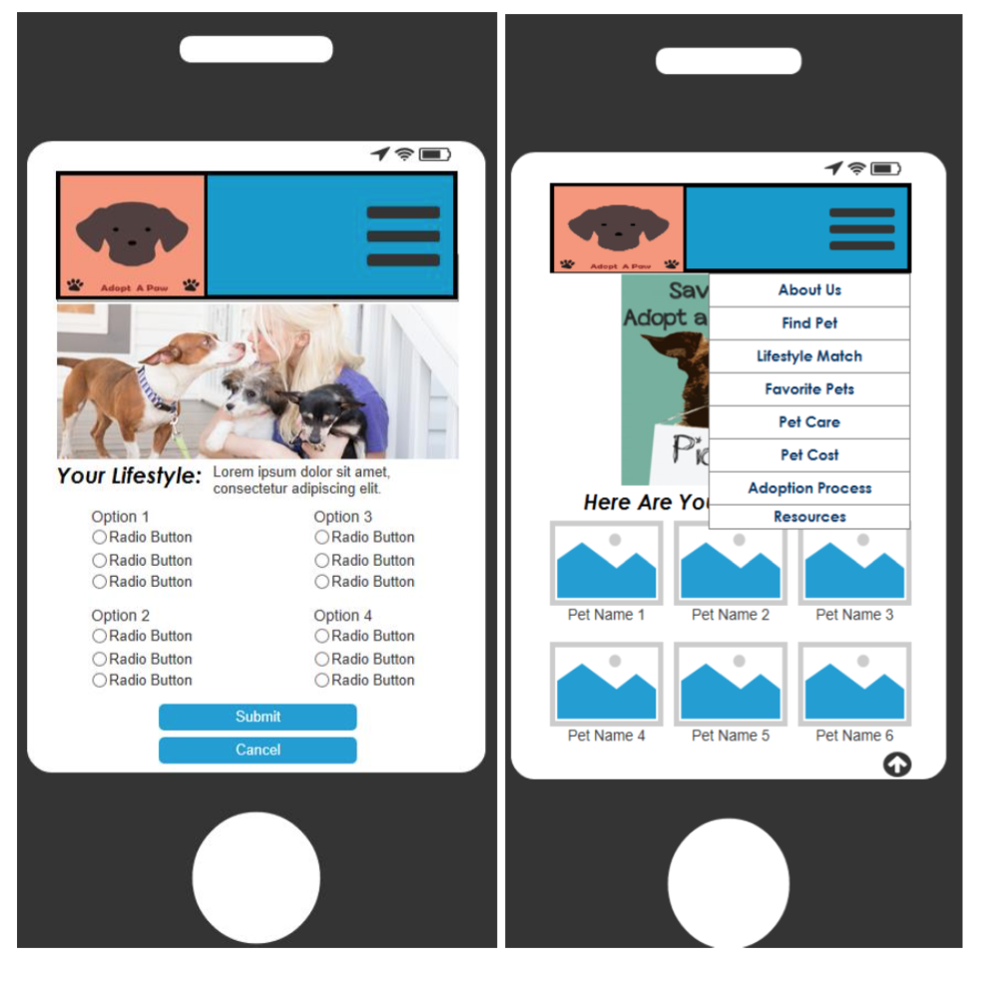
Lifestyle Questionnaire and Gallery of Matched Pet pages
Lifestyle Questionnaire has various questions to help the user find a pet match
Gallery of Matched Pets displays after user submits Lifestyle Questionnaire

Slide 27
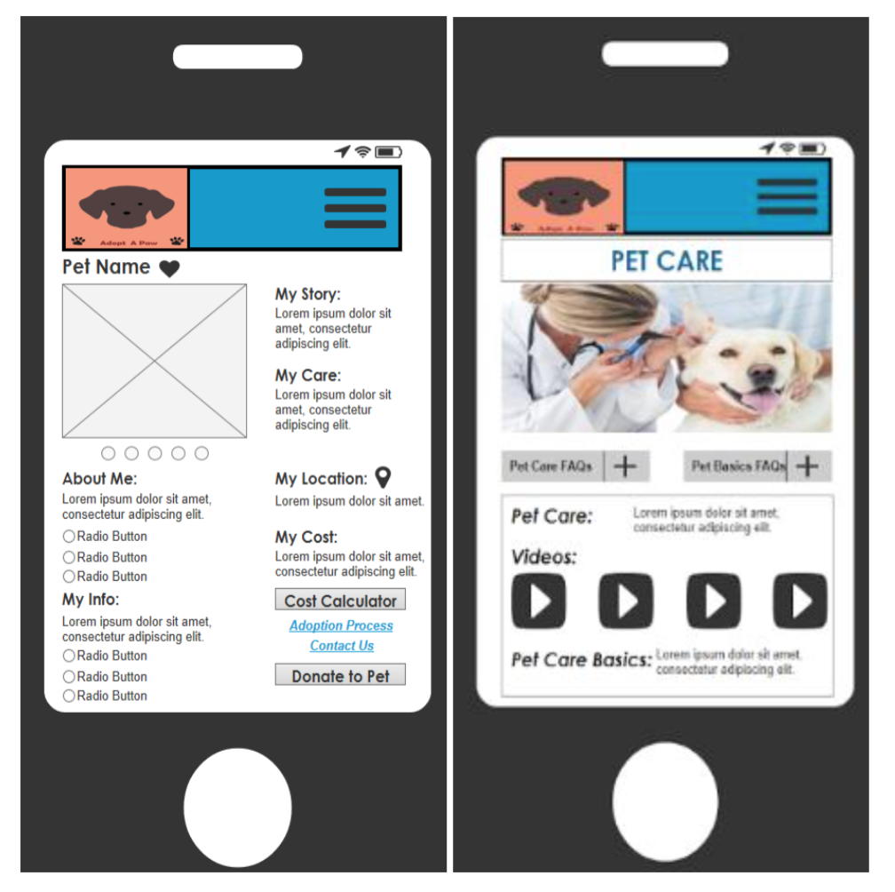
Detailed Pet and Pet Care Page
The detailed pet page gives the user all important information about the pet
Pet Care page gives general information on how to care for a pet

Slide 28
Insights From Structured Inspection

Slide 29
Heuristic Evaluation
This heuristic evaluation was based off the low fidelity wireframes due to time restraints and are intended to scope out early issues with the app. Future recommendation would be to do another heuristic evaluation of the detailed prototypes at a later date.
The following features were not in scope for this project:
Creating an account
Signing in/signing out
Sign up later
About Us
Find Pet
My Favorite Pets
Resources

Slide 30
Heuristic Evaluation
Visibility of system status
Appropriate feedback is given for touch points within the scope of this design. Every action or non-action will effectively give the user the current state of what is going on. A further analysis should be done when working prototypes are completed.
Logo is meaningful, visible, and identifiable at all times
An About Us section is available in the menu but label for Contact Us. There could and
should be contact information in the About Us section and a link in the menu, on various
pages and in the footer if applicable
Load time that may affect the user's experience is not obtainable for this evaluation
Match between system and the real world
Unfortunately, content was not created for this project. All content, terms, labels, and actionable items are/will be written in a way that keeps
with standard use regarding pet adoption and items related to cost and care of pets. Unfortunately, content was not created for this project and therefore not applicable at this time.
Icons are concrete and familiar
Menu items are logical and fit into categories that are readily understandable
System will automatically enter dollar sign and decimals

Slide 31
Heuristic Evaluation
User control and freedom
The user has the ability to navigate using various options such as the menu toggle (hamburger), call to action buttons and links throughout the app.
The Lifestyle page has a form for the user to fill out allowing them to cancel or submit the form. However, there is no indication of the amount or type of questions the user will encounter or if any if them are required in order to submit the form. Also, no indication how the user will receive feedback after they submit the form. At the moment, it looks as though they are taken to a page with pet matches but there is nothing that indicates that to the user.
There is a similar issue on the cost calculator page where there is no clear indication that a user needs to be required to fill out every field. According to the comps, the calculation is done automatically without a submit button.

Slide 32
Heuristic Evaluation
Consistency and standards
Unfortunately, content was not created for this project and detailed prototype not available. Further evaluation should be revisited next iteration.
Wording used will be consistent throughout the app and any situations that might differ will have explanations or instructions for the user
Apps goals are well defined and deliver look and feel that corresponds with goals of app
Users can switch orientation with no issues
All data fields are labeled appropriately and appear either to the left or above the field
Menu structure and names match across the app
Error Prevention
No clear error prevention is indicated in wireframe but suggestions are in annotations.
Menu choices are logical and distinctive
There are no system warnings for the user if they are about to make an error such as entering the wrong data type in data field
No indication of constraints to amount of characters allowed in data field

Slide 33
Heuristic Evaluation
Recognition rather than recall
All objects, actions and options will have clear labels or instructions.
The plus icon users recognize as expand/collapse. Users have experience with this and know that they will find more information if tapped upon. Expand/collapse allows for relevant information to be available to the user without taking up a lot of real estate.
When a page is long and requires an excess amount of scrolling, an arrow icon (page up) allows the user to tap and be taken back to the top of the page
On the Adoption Process page the use of a document download icon is used to give the user a visual clue as to the purpose of that element
Data entry fields are not clearly marked as optional or required
Flexibility and efficiency of use
At this time a search was not in scope for this project. A further analysis would need to be done to determine the usefulness of a search for this particular app.
The links within the app are clearly indicate where the user is and link to related content relevant to the topic

Slide 34
Heuristic Evaluation
Aesthetic and minimalist design
Wireframes being evaluated are showing a minimalist design and should be re-evaluated with detailed prototype.
Labels are clearly defined, brief, familiar, and descriptive allowing the user to navigate between similar topics.
Layout is clearly designed to avoid visual noise adding icons and imagery where appropriate
Carousel on Pet Detail page can be swiped or pagination can be tapped to move back and forth between images
No indication if user is able to make image larger by tapping
Thumbnails of videos might be too small for user to distinguish, avoid 2:2 and stack video clips
Add textual description to video so users know what video is about
All icon use is relevant to the context in which they are used
Navigation is designed to be accessible at all times and is only one layer deep making for a simplistic design

Slide 35
Heuristic Evaluation
Help users recognize, diagnose, and recover from errors
There are no clear error messages indicated in the wireframes at this time. Annotations have suggested areas that may be in need of error messages. These areas relate to input errors in a form fields found on the Lifestyle questionnaire and Cost Calculator. Error messages should be incorporated and displayed in language that will be understandable by the majority. It will also give the user options on how to recover from issue.
Help and documentation
There isn’t a formal help document but instead specific sections have FAQs related to the topics of that area. For example, there are FAQs found in Pet Care, Pet Cost, and Adoption Process section. These allow the user to find general information without having to leave the app and search elsewhere. A help document or FAQs related to the systems functions should be implemented in the next iteration and will more than likely be located in the footer along with a contact us section.

Slide 36
Heuristic Evaluation
Skills
The system supports both novice and expert users. Those who just want information to those who want to find a pet match and use the “favorites” as a way if selecting a pet.
Pleasurable and respectful interaction with user
Typing requirements are minimal for question interfaces
User only has to enter zip code and system calculates list in their area
System does not correct typos or offer corrections
Privacy
No privacy issues at this time. If app is further developed to include creating an account and selecting favorite pets to view later, then appropriate privacy settings will be applied.

Slide 37
Insights From Usability Evaluation

Slide 38
Insights from Usability Evaluation
We are updating prototype and will be conducting user testing in the next day or so.

Slide 39
Key Insight

Slide 40
What We Learned
To be conducted this week

Slide 41
Next Steps

Slide 42
What next?
If this project were to go further, findings from the usability evaluation would be incorporated into the detailed prototype and another iteration of user testing would be conducted.
Present the timeline.
Solicit comments on these slides and/or user evaluation on these prototypes and incorporate into the design..
Another round of user testing and updates to documentation.

Slide 43
Timeline
User research
Wireframes
Review
Prototype
User testing
Requirements gathering
Wireframes
Dev hand-off

Slide 44
Questions?

Slide 45
Resources for Images
https://pixabay.com/en/photos/animal%20shelter/
https://www.pexels.com/search/dogs%20with%20people/
http://www.dailymail.co.uk/news/article-2539276/Animal-shelter-bans-public-looking-dogs-seeing-people-time-makes-SAD.html

